Slide 1
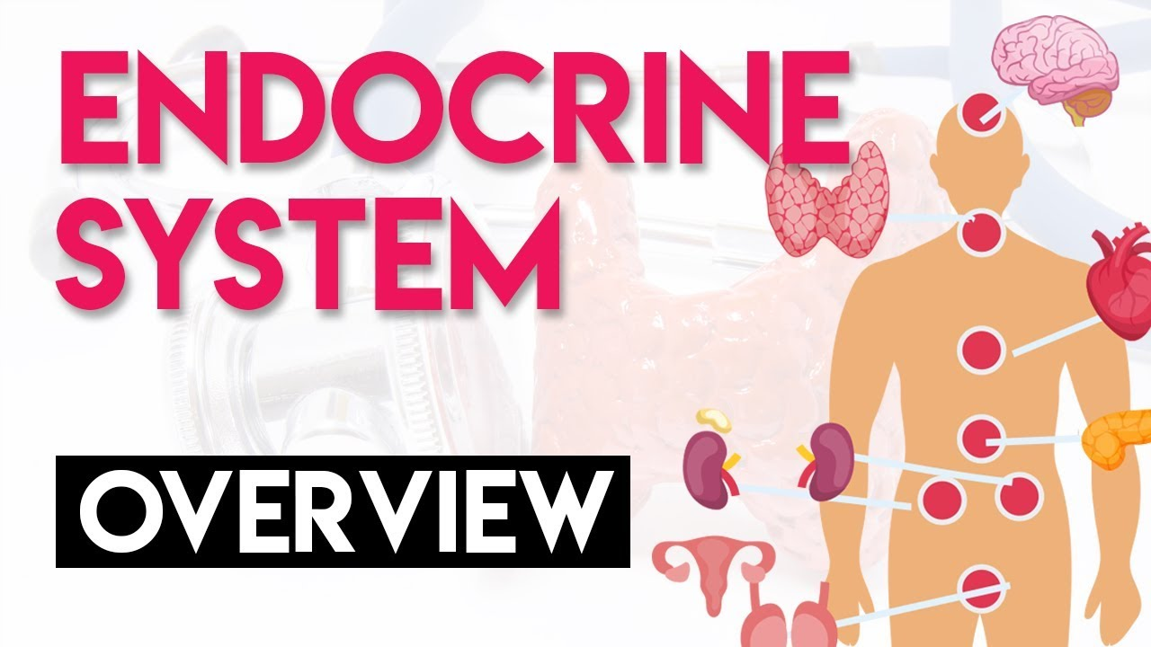

Year 12 Human Biology Test Revision Mr Yates

Slide 2
Students will be able to:
Today we are learning about the Endocrine Glands.
Name and locate endocrine glands in the body.
Know the hormones secreted from each gland, the target cells and the effects it has.

Slide 3
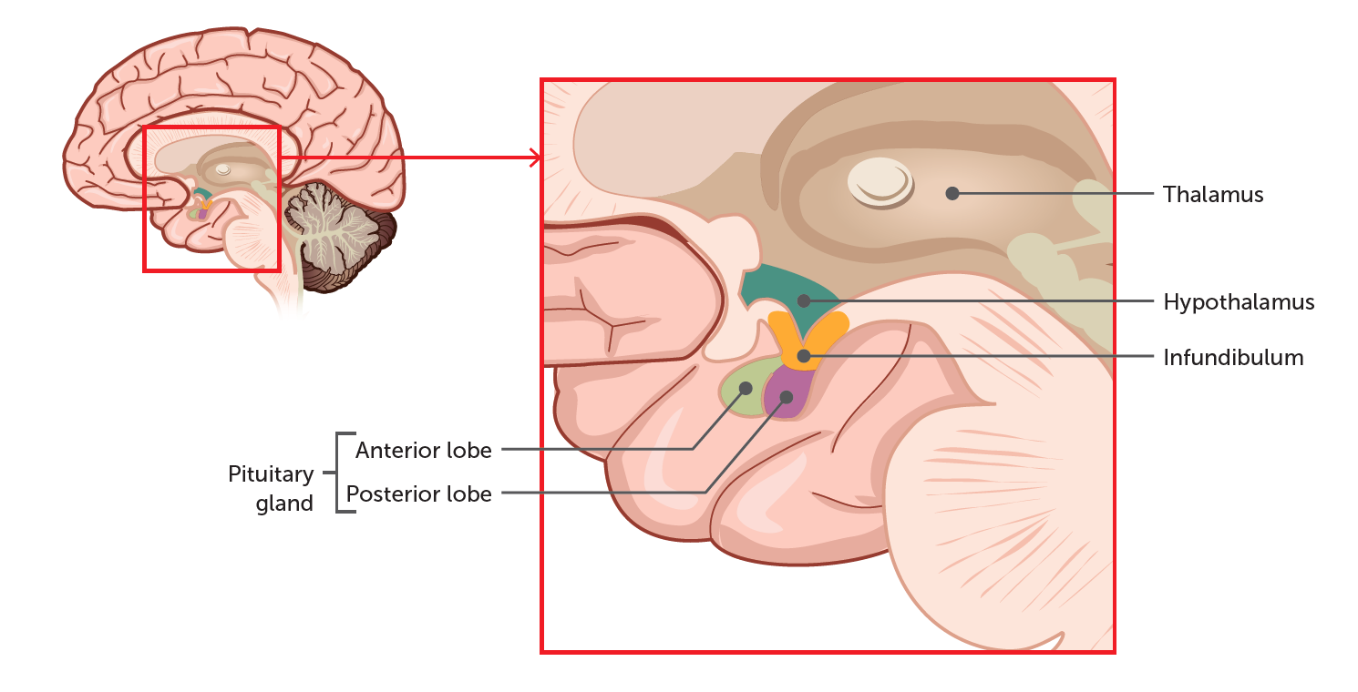
The hypothalamus and pituitary gland
The hypothalamus is located at the base of the brain, and is involved in the regulation of many of the body's most basic functions. The pituitary gland is located just beneath the hypothalamus and is involved in the regulation of various endocrine glands. The pituitary is made up of two lobes - the anterior and posterior - and they function separately.
Notes:
Teacher Cue – refer to the vocabulary box as you read through and “unpack” the definition provided. Use hand gestures to emphasise the ”2 or more”, “mixed” and “separated” parts of the definition.
Have students complete CFU 1 as a pair-share, then record these definitions & examples as notes (with diagrams) if desired.
CFU 2 – pair-share, then whiteboards for answers – call on non-volunteers.

Slide 4
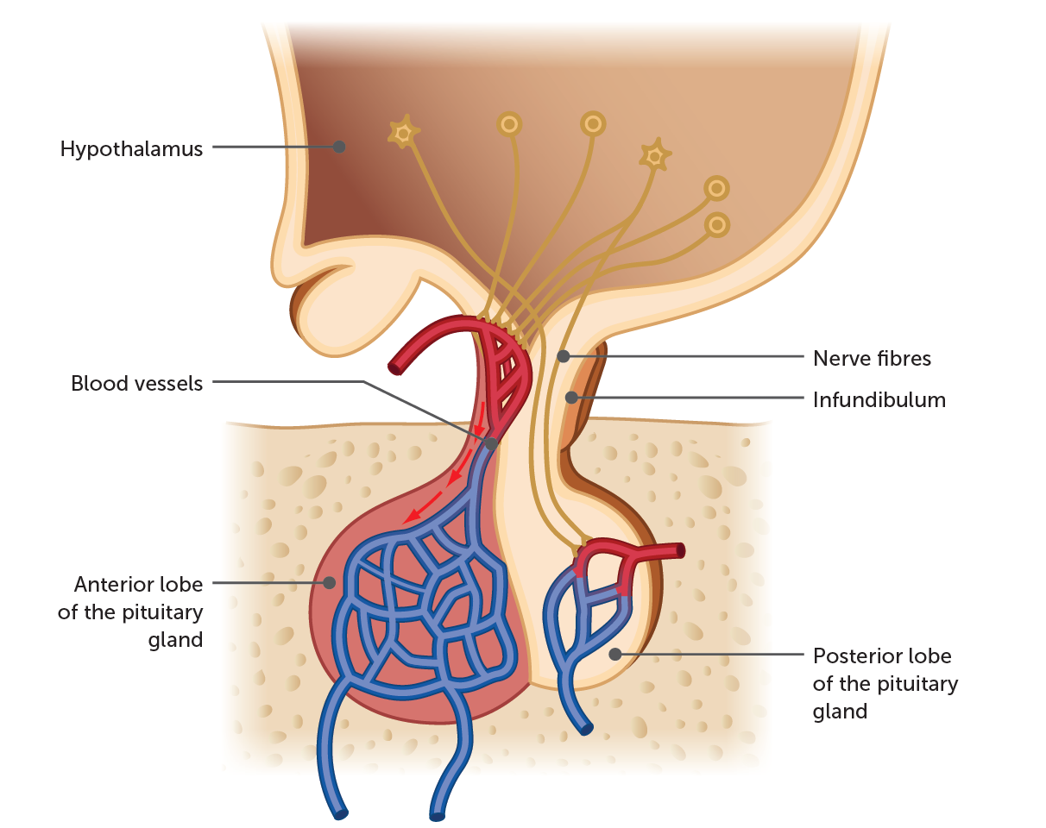
The hypothalamus and pituitary gland
The hypothalamus is connected to the pituitary gland by a structure called the infundibulum, which contains a complex network of blood vessels and nerve extensions. The blood vessels are used to connect the hypothalamus to the anterior lobe of the pituitary, while the nerve extensions connect it to the posterior lobe. These connections allow the pituitary gland to carry out many regulatory functions on behalf of the hypothalamus.

Slide 5
The hypothalamus and pituitary gland
Anterior lobe: the functions of this lobe of the pituitary are regulated by releasing and inhibiting factors produced in the hypothalamus. These factors are secreted by cells in the hypothalamus and are transported to the lobe by the connecting blood vessel network contained within the infundibulum.
Gonadotropic hormones: stimulate the gonads.
Follicle stimulating hormone (FSH): involved in the maturation of follicles in the ovaries: production and maturation of sperm in the testes.
Luteinising hormone (LH): works with FSH to cause ovulation in females; targets the interstitial cells in the testes and stimulates production of androgens.
Growth hormone (GH): promotes body growth by increasing the rate at which the cells take up amino acids, hence increasing the rate of protein production.
Thyroid stimulating hormone (TSH): promotes the release and production of thyroxine in the Thyroid gland.
Adrenocorticotrophic hormone (ACTH): regulates the production and release of corticosteroids from the adrenal cortex.
Prolactin/lactogenic hormone: produces and maintains milk secretion.

Slide 6
The hypothalamus and pituitary gland
Posterior lobe: it is important to note that the posterior lobe of the pituitary is not actually a gland as it does not produce the hormones that it secretes. The hormones themselves are manufactured in nerve cells in the hypothalamus. The hormones then move along the nerve extensions connecting the hypothalamus to the posterior lobe and are stored there, until a nervous impulse from the hypothalamus stimulates their release.
Oxytocin (OT): causes contractions of the muscles in the uterus and cells surrounding the mammary glands.
Antidiuretic hormone (ADH): promotes the removal of water from urine by the kidneys, which can then be returned to the bloodstream.

Slide 7
Glands
Endocrine glands: secrete hormones into the extracellular fluid, which then pass into the blood for transport.
Exocrine glands: (not a part of the endocrine system) secrete hormones into a duct which transports them to a cavity or the body surface; for example, sweat glands in the skin, and salivary glands in the mouth.
For the most part, we are interested in the endocrine glands.

Slide 8
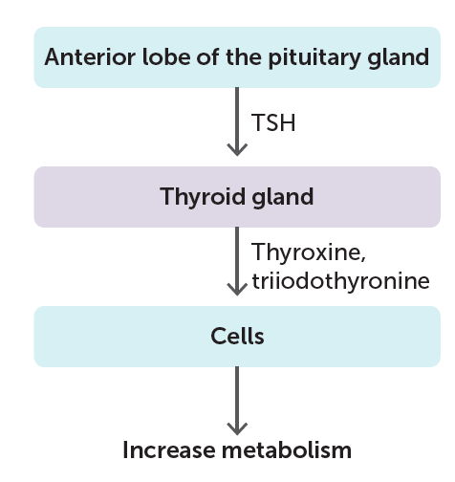
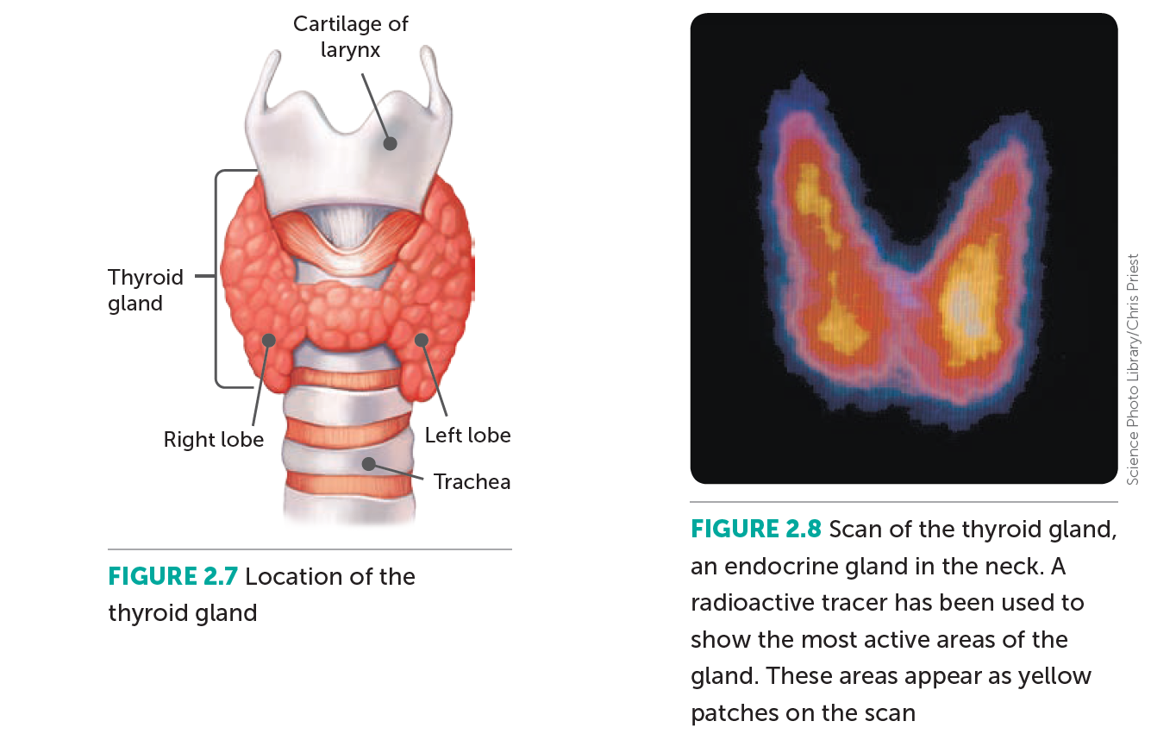
Thyroid
The thyroid is a two-lobed gland situated beneath the larynx, with one lobe either side of the trachea. This gland is responsible for the release of thyroxine, a hormone composed of iodine and the amino acid tyrosine.
Thyroxine is used in the regulation of metabolic processes in the body such as degradation of complex molecules to release energy, and the production of complex molecules from simple molecules which consume energy. Because the function of thyroxine is closely linked with the production and consumption of energy, it is also complicit in maintenance of body temperature. The secretion of thyroxine from the thyroid is promoted by thyroid stimulating hormone (TSH) released from the anterior pituitary gland.

Slide 9
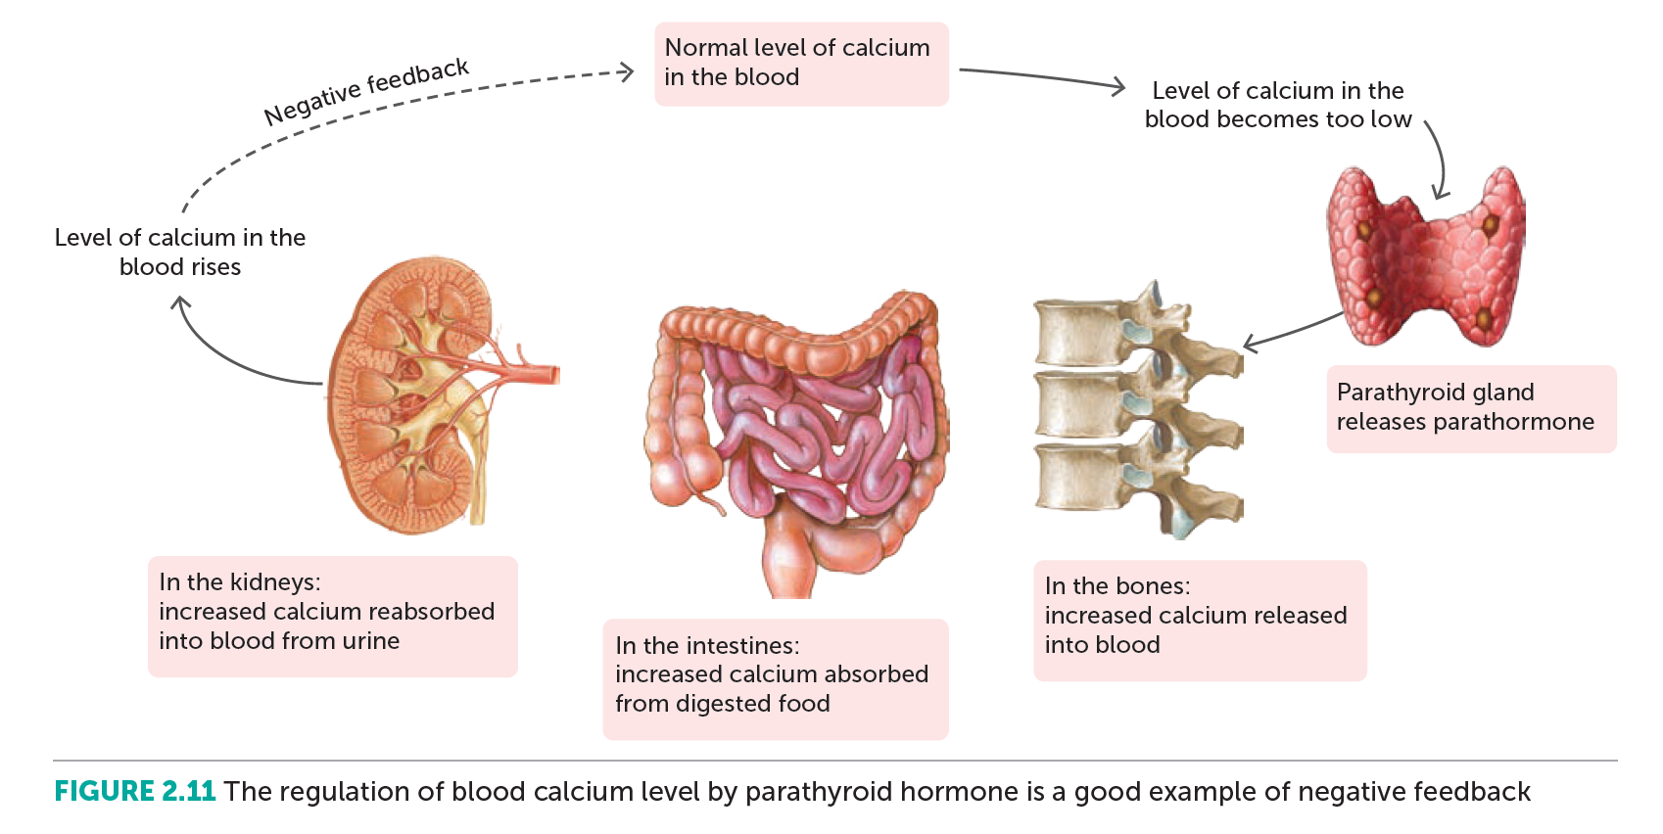
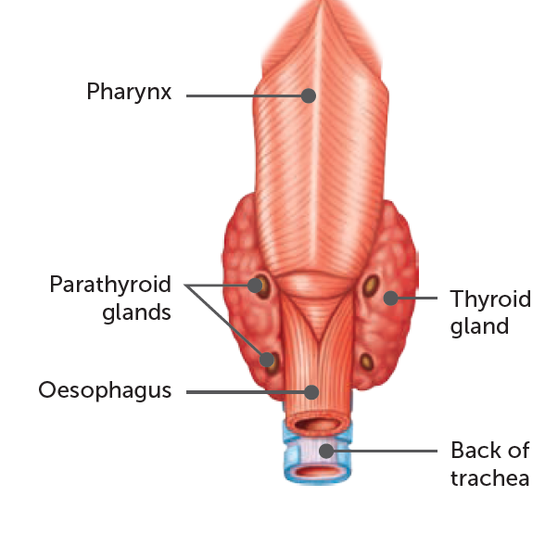
Parathyroid
There are normally approximately four parathyroid glands embedded in the back of the thyroid lobes. These glands secrete parathyroid hormone (PTH) which maintains levels of calcium and phosphate in the blood. This regulation is an excellent example of a negative feedback mechanism, as the parathyroid hormone is released in response to low blood calcium levels, causing calcium to be released from bones. which is reabsorbed from urine and absorbed in greater amounts from digested food. This causes blood calcium levels to rise and the amount of parathyroid hormone secreted is decreased in response.

Slide 10
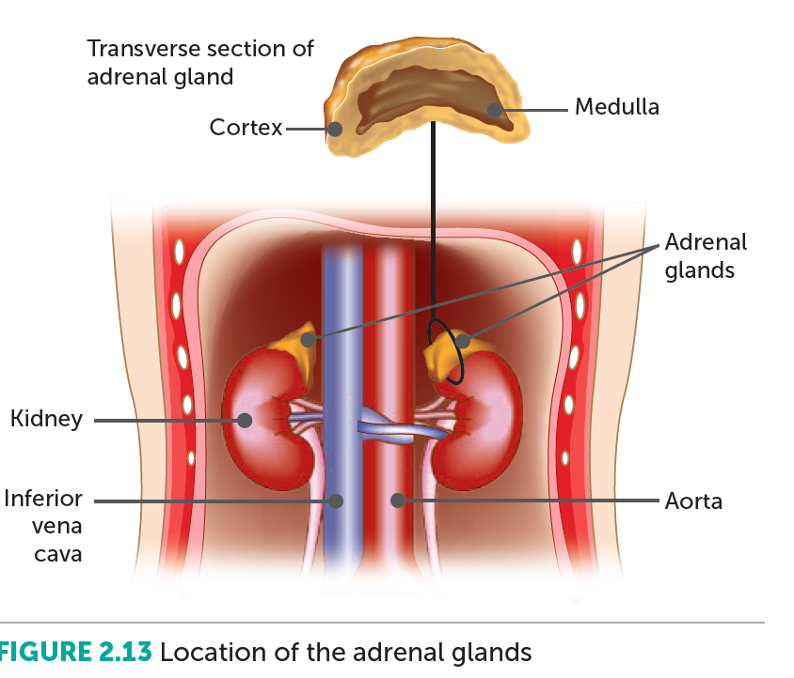
Adrenal glands
Located on the tops of the kidneys, the adrenal glands consist of two components: the inner part of the gland is called the adrenal medulla, and the outer layer surrounding that is the adrenal cortex.
The adrenal medulla is responsible for the secretion of two hormones:
Adrenaline/epinephrine: prepares the body for threatening situations by initiating the fight-or-flight response (discussed in more detail later).
Noradrenaline/norepinephrine: performs much the same function as adrenaline/epinephrine with an emphasis on increasing the rate and force of the heartbeat.
The adrenal cortex secretes a group of more than 20 hormones known as corticosteroids, the most important of which are:
- Aldosterone: acts on the kidney to change the composition of urine by reabsorbing sodium and excreting potassium.
- Cortisol: promotes normal metabolism, allows the body to cope with stress, and aids in the repair of damaged tissues.

Slide 11
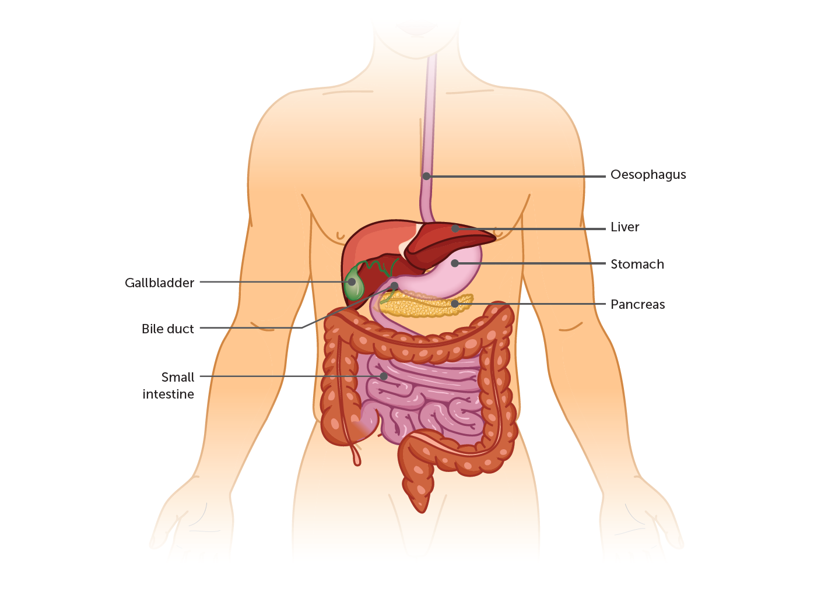
Pancreas
The endocrine function of the pancreas is mainly involved in the regulation of blood sugar levels through the secretion of two hormones from specialised cells called the pancreatic islet cells. These hormones are:
Insulin: responsible for lowering blood glucose by promoting the uptake of glucose from the blood into the cells of the body, and its conversion into glycogen and fat.
Glucagon: responsible for increasing blood glucose levels through the promotion of glycogen/fat breakdown, producing glucose.
KEY POINT: Both insulin and glucagon work via a negative feedback mechanism.

Slide 12
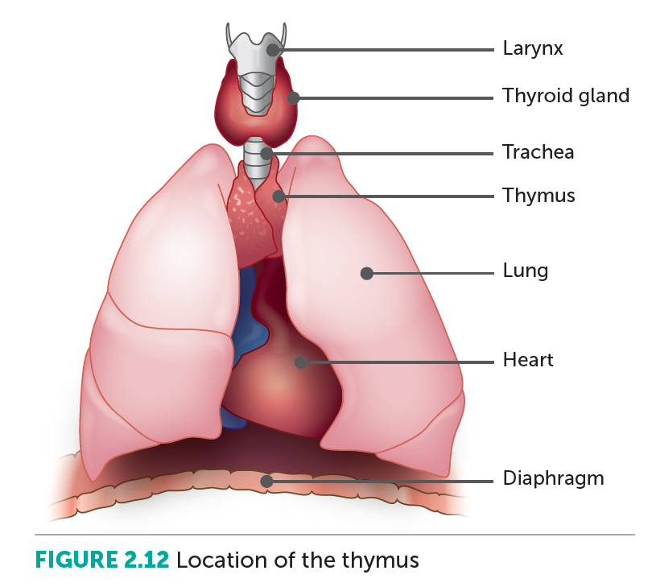
Thymus
The thymus is a gland located in the chest cavity, above the heart and behind the sternum. The thymus be gins to shrink in size after puberty due to its reduced importance and function in adulthood. The hormones that it secretes are called thymosins, which are required for the maturation of the T-cells/T-lymphocytes that play a vital role in the immune system.

Slide 13
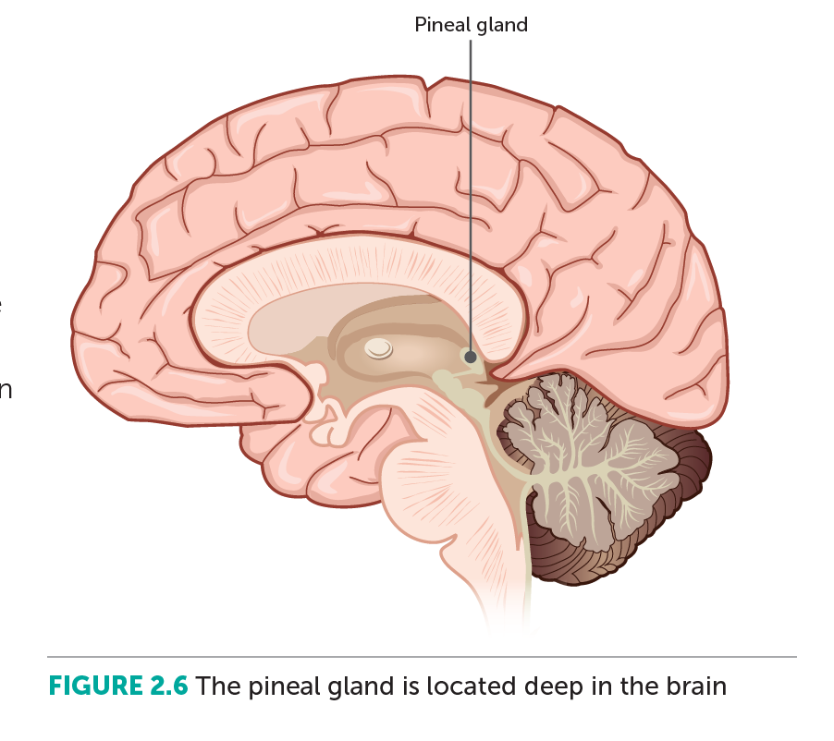
Pineal gland
The pineal gland is located deep within the brain, and like the thymus, it decreases in size after puberty. The most important role of this gland is the production and secretion of melatonin, which plays a role in the regulation of sleep patterns. The secretion of melatonin is promoted by darkness and inhibited by light.

Slide 14
Gonads
The testes and ovaries are collectively known as the gonads, and they also function as endocrine glands.
- Testes: secrete androgens (male sex hormones) which are responsible for the development and maintenance of secondary sexual characteristics in males.
- Ovaries: secrete oestrogens and progesterone (female sex hormones).
Like androgens in males, these allow for development and maintenance of secondary sexual characteristics in females, how ever they also work with the gonadotropic hormones produced by the pituitary to regulate menstruation and pregnancy.

